Slide 1

Draw Like No One is Watching
Relax While Fostering Creative Problem Solving

Slide 2
“Creative activity is a type of learning process where the teacher and the pupil are located in the same individual.” ~Arthur Koestler

Slide 3
First, we must unblock.
Artist brain is our inventor, our child, our very own absent-minded professor. Artist brain says, “Hey! That is so neat! Artist brain is our creative, holistic brain. It thinks in patterns and shadings.
What we are talking about is an induced—or invited—spiritual experience.
If you think of the universe as a vast electrical sea in which you are immersed and from which you are formed, opening to your creativity changes you from something bobbing in the sea to a more fully functioning, more conscious, more cooperative part of that ecosystem. ~Julia Cameron

Slide 4

Then we must move past self-judgment. Do the work, don’t judge the work. What creative activities do you like to do?

Slide 5

Creativity is just connecting things. When you ask creative people how they did something, they feel a little guilty because they didn't really do it, they just saw something. It seemed obvious to them after a while. That's because they were able to connect experiences they've had and synthesize new things. ~Steve Jobs

Slide 6
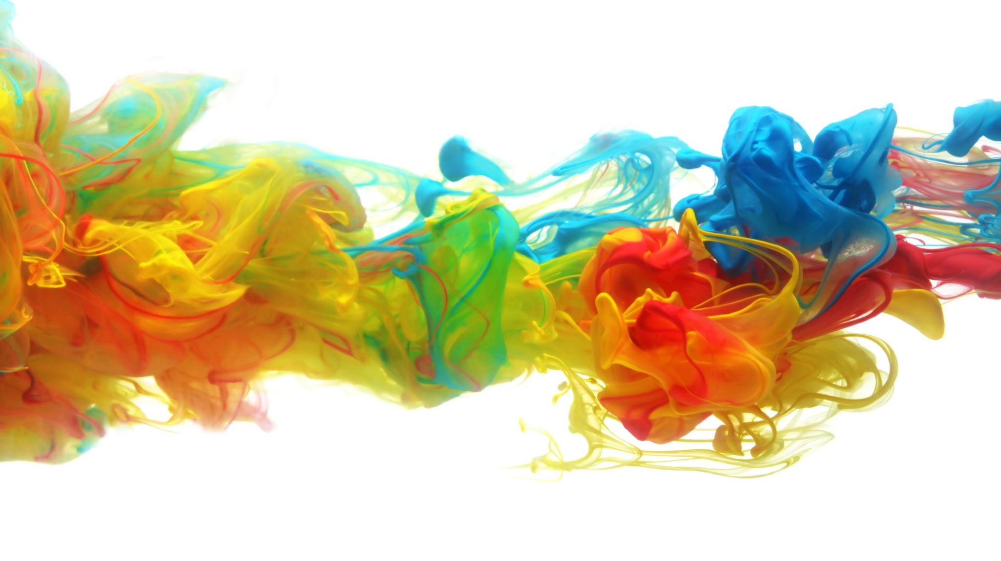
What happens to our brains when we operate in creative mode versus uncreative mode?
Creative mode is called for in contexts that are unclear, vague and open-ended. It involves turning away from the path of least resistance and venturing into the briars in an effort to forge a new path through the gray zone of the unexpected, the vague, the misleading or the unknown.
Creative mode turns off the receptive-predictive cycle of the brain and turns on the explorative-generative cycle. In creative mode, the brain becomes more integrative and dynamic.
The Neuroscience of Creativity: A Q&A with Anna Abraham, Scientific American, January 2019

Slide 7
What is creative mode?
The “Big Three” brain networks — the default mode network, the executive control network, and the salience network.
Prior research suggests that they work together when it comes to being creative.
The default mode network is what's happening in the brain in a resting state, the brain’s “idle state.”
The executive control network monitors what is going on, manages emotional parts of the brain, directs resources like attention, and oversees decisions and choices.
The salience network determines which sorts of things tend to be noticed, and which tend to fly under the radar. In PTSD, for example, the salience network is scanning for threats.
Your Brain on Creativity, Dr. Grant Brenner, Psychology Today, Feb 2018

Slide 8
What is creative mode?
For creativity, scientists hypothesize that the Big Three operate as a team: the default mode network generates ideas, the executive control network evaluates them, and the salience network helps to identify which ideas get passed along to the executive control network.
On top of this basic schema, these networks can also influence one another via other feedback loops. For instance, the executive control network might “tune” the way the salience network scans internally, depending on the task at hand, in response to the environment.
These brain networks form a somewhat flexible and responsive system, a "complex adaptive system" (search that on the internet). Not only is it a resilient learning system, obviously the brain has also evolved in relation to the environment.
Your Brain on Creativity, Dr. Grant Brenner, Psychology Today, Feb 2018

Slide 9

How exactly does creativity help your brain solve problems?

Slide 10
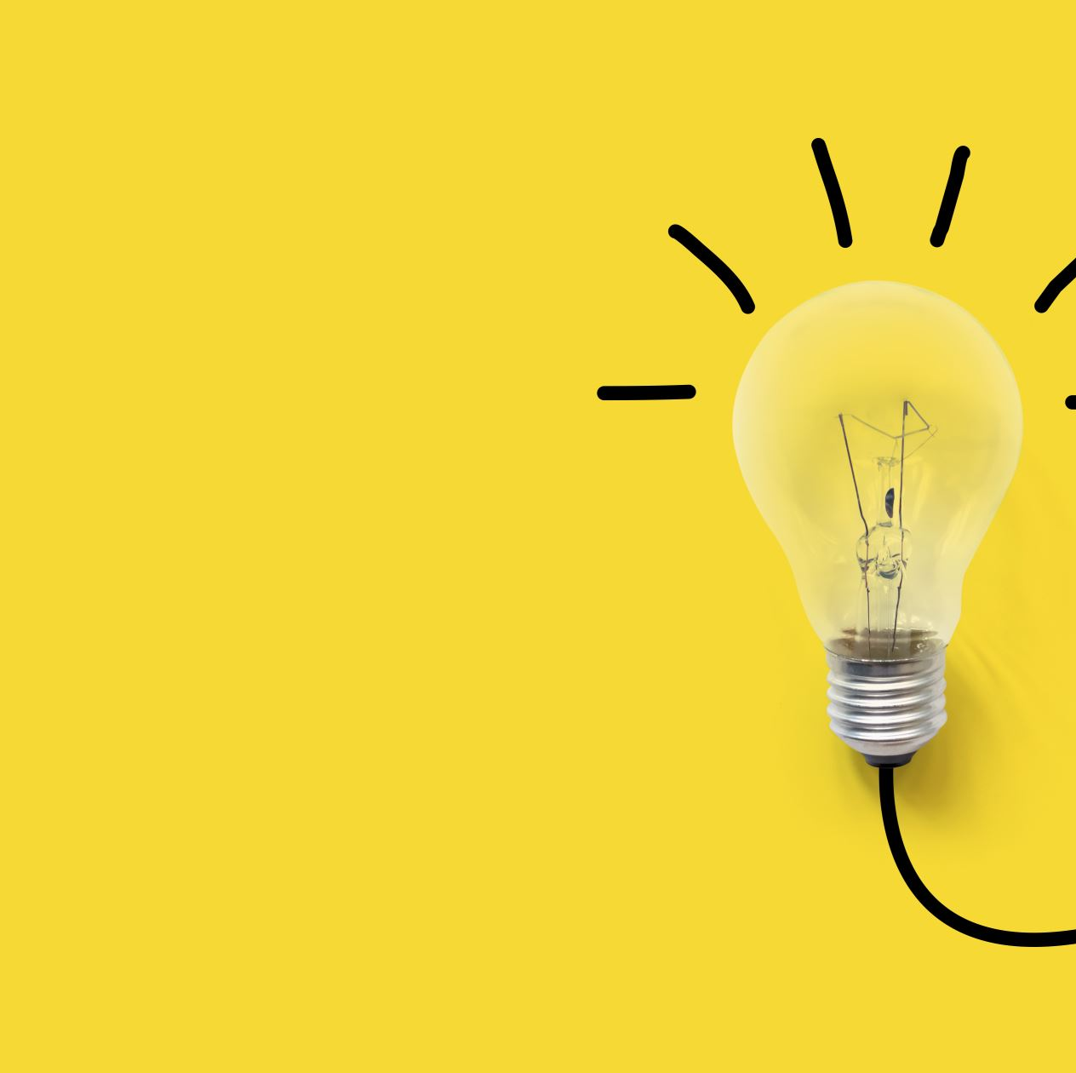
Creativity in and of itself is important for remaining healthy, remaining connected to yourself and connected to the world.”
~Christianne Strang, professor of neuroscience, Univeristy of Alabama Birmingham
It helps you imagine a more hopeful future.
It activates the reward center of your brain.
It lowers stress.
It lets you focus deeply.
It helps you process your emotions.
It increases brain plasticity.
Feeling Artsy? Here’s How Making Art Helps Your Brain, NPR, January 2020

Slide 11

Hopeful future
Helps us to navigate problems that might arise in the future
Making the decisions during the art making process puts us the mindset of solving future problems by imagining what is to come and to see the possibilities beyond the present moment

Slide 12

Activates reward center
Any visual expression activates the brain’s reward pathway and makes you feel good
Can help rewire other unhealthy habits like addictive behaviors, eating disorders and mood disorders
Girija Kaimal, art therapy researcher, Drexel University

Slide 13

Lowers stress
Lowers cortisol levels

Slide 14

Focus deeply
Induces “flow”…what happens when you are “in the zone”
The sense of losing yourself, losing all awareness, being in the moment, fully present
Including with our emotions, being with them and not turning away from them

Slide 15

Doodling versus Drawing
Doodling is drawing usually while engaged in another activity
Doodling has many benefits including freeing up short and long-term memory, improving retention, and increasing attention span. It engages the “default” networks in your brain that might otherwise be dormant, allowing more networks to fire at once
Our minds are habit forming so doodling helps us break our normal patterns of thinking by forcing us to think in an unfamiliar medium (visual)
Julia Rabin, Stuck in a Creative Rut, mediablog.prnewswire.com, July 2017

Slide 16

Let’s draw! Take a piece of paper and for 5 minutes, draw up to 15 different marks on the page.

Slide 17

Draw either a flower, a favorite food or a tree.

